Slide 1
Metal Forming

Slide 2
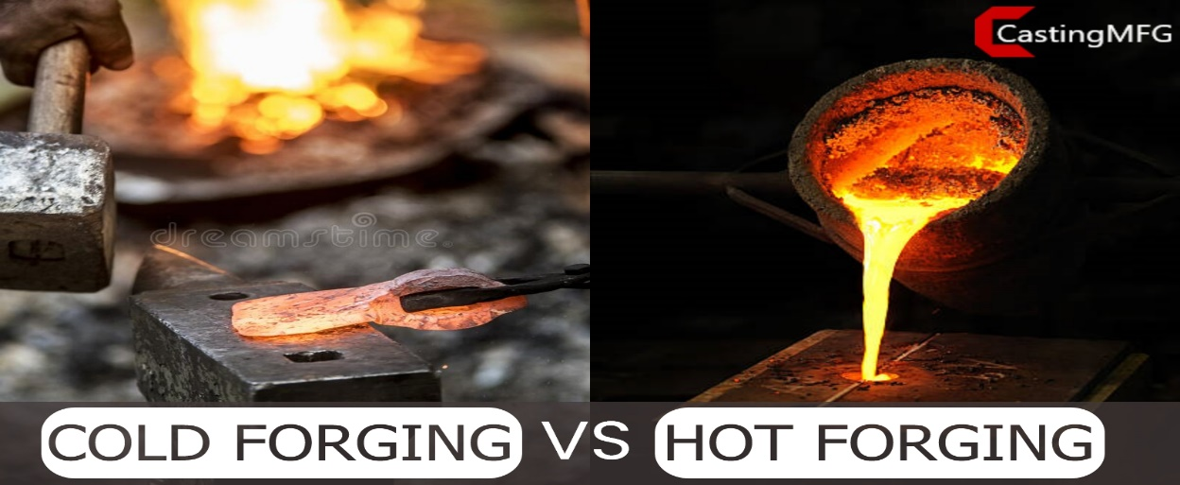
Outline
Fundamentals of Metal Forming
Bulk deformation
Sheet metalworking

Slide 3
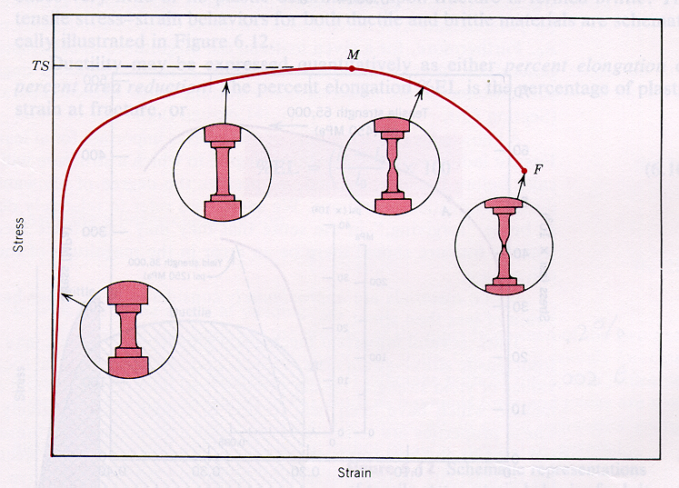
Plastic Deformation
Max Load
Plastic region
A
Elastic region
Notes:
Prior to True stress (TS), the stress in the specimen is uniformly distributed.
After TS, necking occurs with localization of the deformation to the necking area, which will rapidly go to failure.

Slide 4
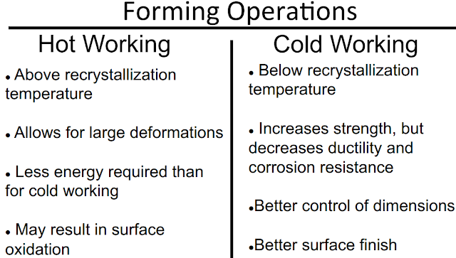
Temperature in metal forming
Better accuracy
Better Surface finishing
Strain hardening increase strength
Costs

Slide 5
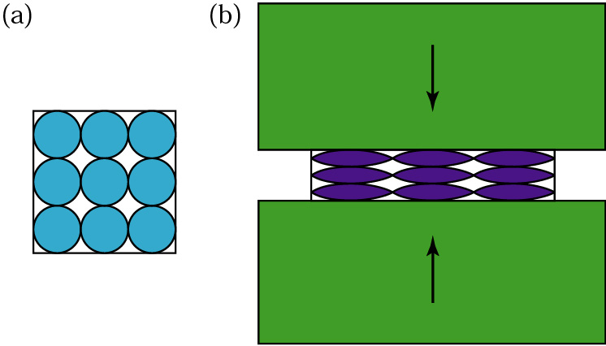
Preferred Orientation
Plastic deformation of idealized (equiaxed) grains in a specimen subjected to compression (such as occurs in the rolling or forging of metals): (a) before deformation; and (b) after deformation. Note the alignment of grain boundaries along a horizontal direction; this effect is known as preferred orientation.

Slide 6
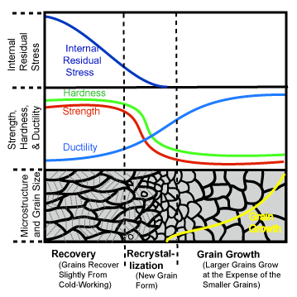
Recrystallization

Slide 7
Cold Working
Metal forming performed at room temp or slightly above (below their recrystallisation temperature
Advantage
Better accuracy
Better Surface finishing
Strain hardening increase strength
Costs
Disadvantage
Higher forces are required
Care the surface
Ductility is limited.

Slide 8
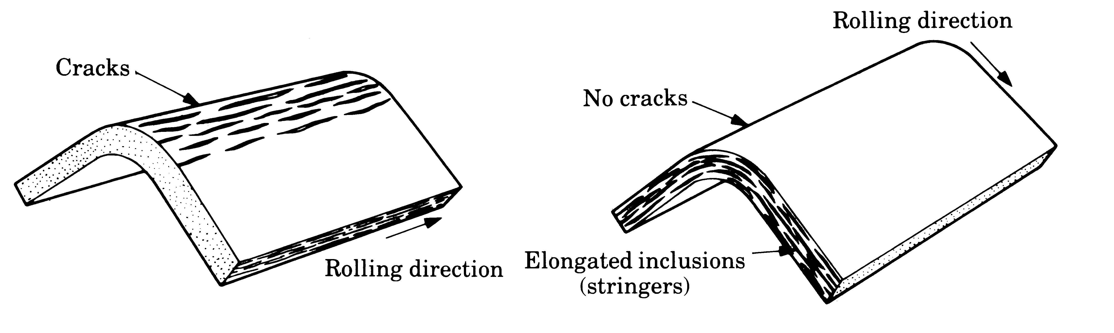
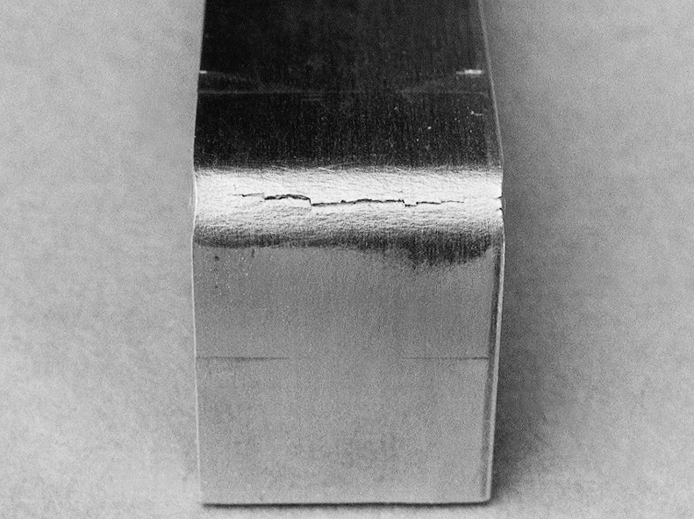
Cracks
(a)
(b)
(c)
Figure (a) and (b) The effect of elongated inclusions (stringers) on cracking, as a function of the direction of bending with respect to the original rolling direction of the sheet. (c) Cracks on the outer surface of an aluminum strip bent to an angle of 90o. Note the narrowing of the tope surface due to the Poisson effect.

Slide 9
Hot working
T above Recrystallization Temp.
0. 5T_{m} < T < 0.75T_{m})
Advantage
  The shape can be significantly altered
  Lower forces are required
  Fracture can be reduced
  Strength properties are generally isotropic
  No strengthing of the part occurs from work hardening
  Disadvantage
  Lower dimensional accuracy, higher energy, poorer surface finish
  Shorter tool life

Slide 10
Warm Working
0.3Tm < T < 0.5Tm
Advantage
  Lower forces are required
  More intricate work geometries possible
  The need for annealing may be reduced

Slide 11
Isothermal
For high speed steel, titanium alloy, good hot hardness
Quick heat transfer
- Raising strength leading to high residual stress
Cracking

Slide 12
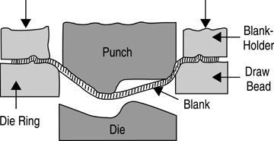
Metal forming process
1. Bulk deformation processes
2. Sheet metal working processes

Slide 13
Bulk Deforming Processes
• Forging
(wrenches, crankshafts)
• Rolling
(I-beams, rails)
often at
elev. T
• Drawing
(rods, wire, tubing)
• Extrusion
(rods, tubing)

Slide 14
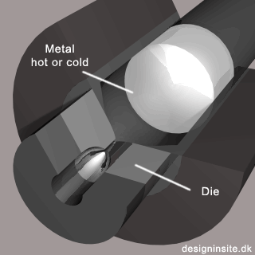
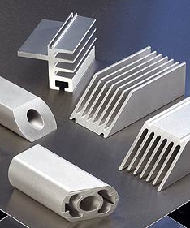
Extrusion
Metal forced/squeezed out through a hole (die)
[source:www.magnode.com]
Typical use: ductile metals (Cu, Steel, Al, Mg), Plastics, Rubbers
Common products:
Al frames of white-boards, doors, windows, …

Slide 15
Drawing
Similar to extrusion, except: pulling force is applied
Commonly used to make wires from round bars

Slide 16
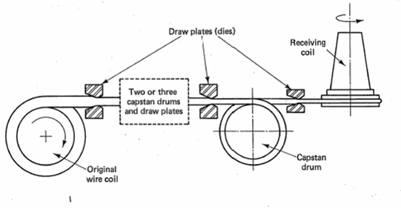
Continuous Drawing

Slide 17
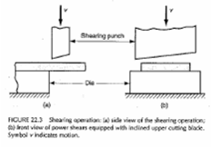
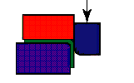
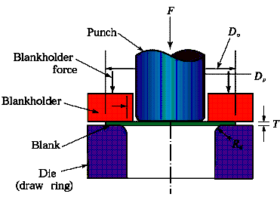
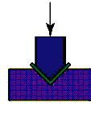
Sheet Metalworking
• Deep drawing
• Bending
• Shearing

Slide 18
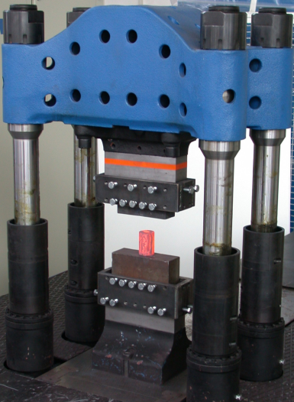
Forging
[Heated] metal is beaten with a heavy hammer to give it the required shape
Hot forging,
open-die

Slide 19
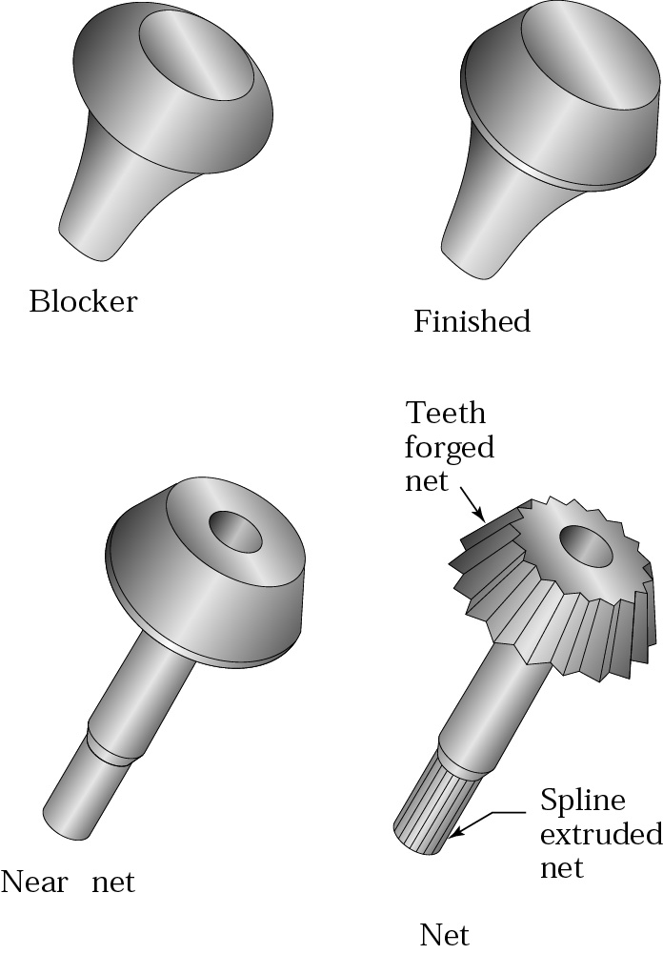
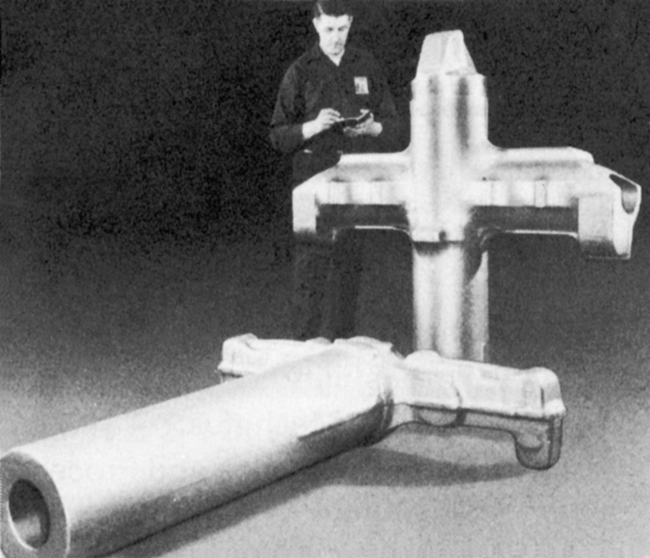
Forging
(a)
(b)
Figure 14.1 (a) Schematic illustration of the steps involved in forging a bevel gear with a shaft. Source: Forging Industry Association. (b) Landing-gear components for the C5A and C5B transport aircraft, made by forging. Source: Wyman-Gordon Company.

Slide 20
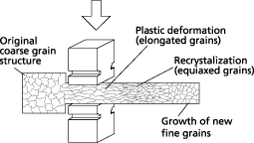
Quality of forged parts
Surface finish/Dimensional control:
Better than casting (typically)
Stronger/tougher than cast/machined parts of same material
[source:www.scotforge.com]

Slide 21
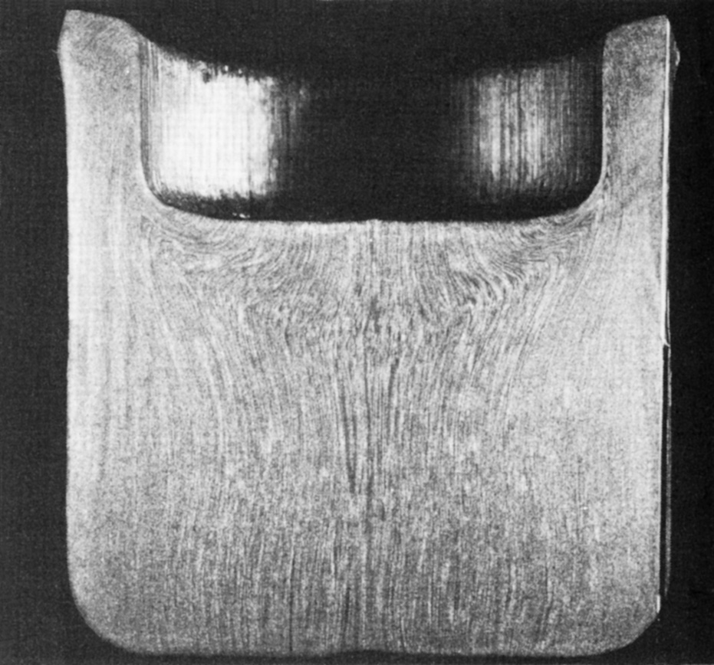
Grain Flow Pattern of Pierced Round Billet
Figure 14.12 A pierced round billet, showing grain flow pattern. Source: Courtesy of Ladish Co., Inc.

Slide 22
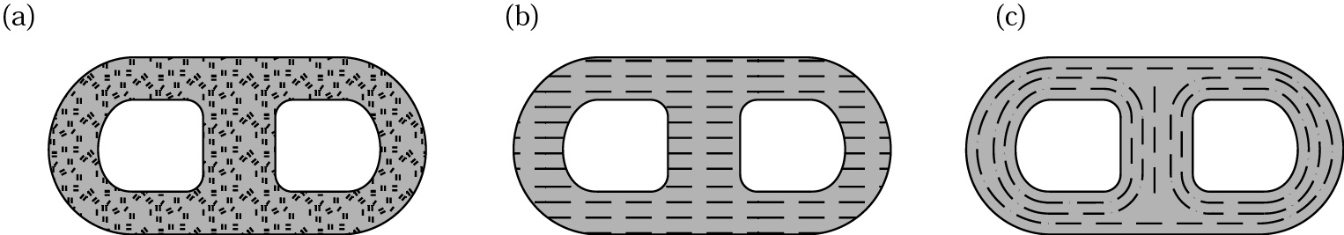
Grain Flow Comparison
Figure 14.3 A part made by three different processes, showing grain flow. (a) casting, (b) machining, (c) forging. Source: Forging Industry Association.

Slide 23
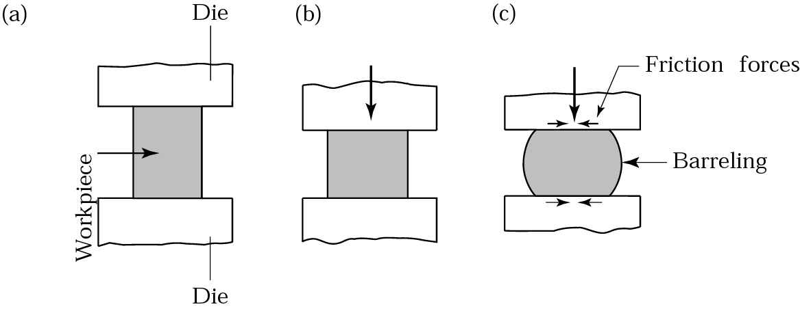
Upsetting
Figure (a) Solid cylindrical billet upset between two flat dies. (b) Uniform deformation of the billet without friction. (c) Deformation with friction. Note barreling of the billet caused by friction forces at the billet-die interfaces.

Slide 24
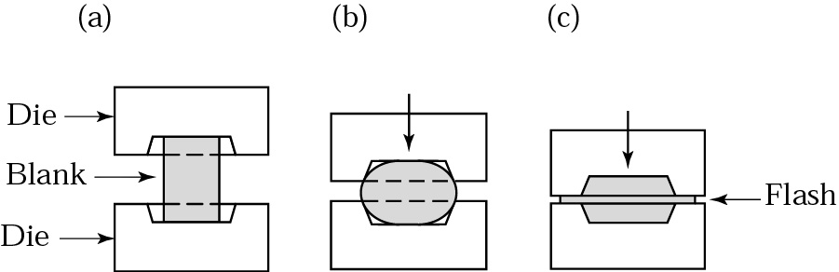
Impression-Die Forging
Figure 14.6 Stages in impression-die forging of a solid round billet. Note the formation of flash, which is excess metal that is subsequently trimmed off (see Fig. 14.8).

Slide 25
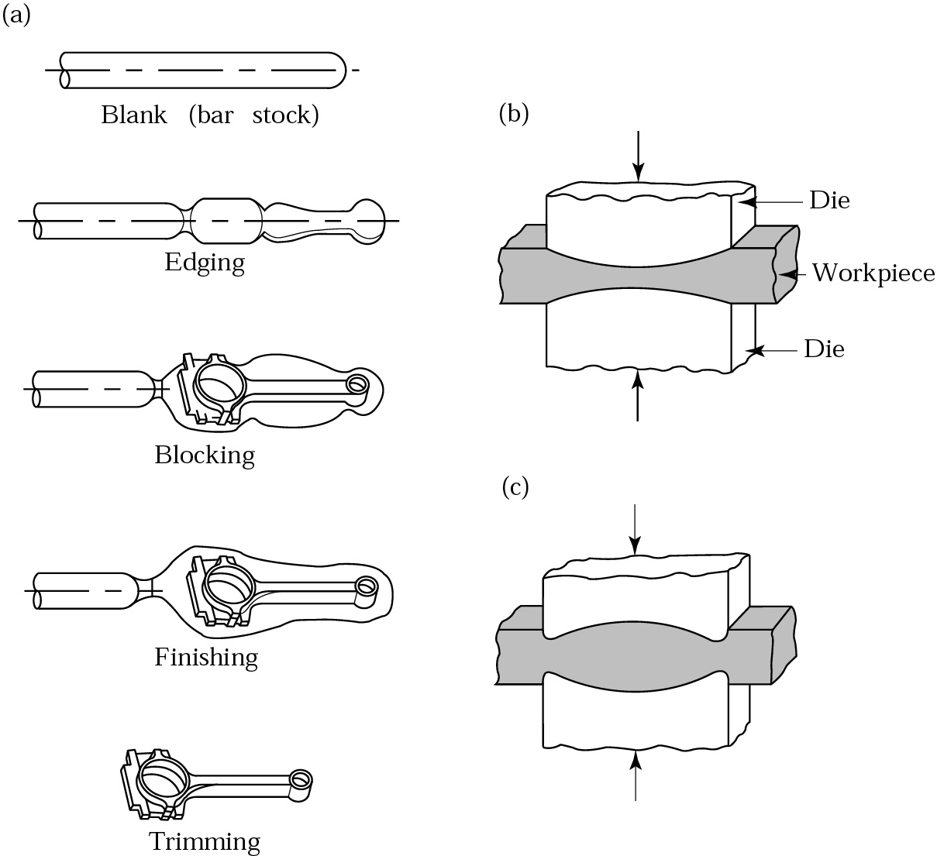
Forging a Connecting Rod
Figure (a) Stages in forging a connecting rod for an internal combustion engine. Note the amount of flash required to ensure proper filling of the die cavities. (b) Fullering, and (c) edging operations to distribute the material when preshaping the blank for forging.

Slide 26
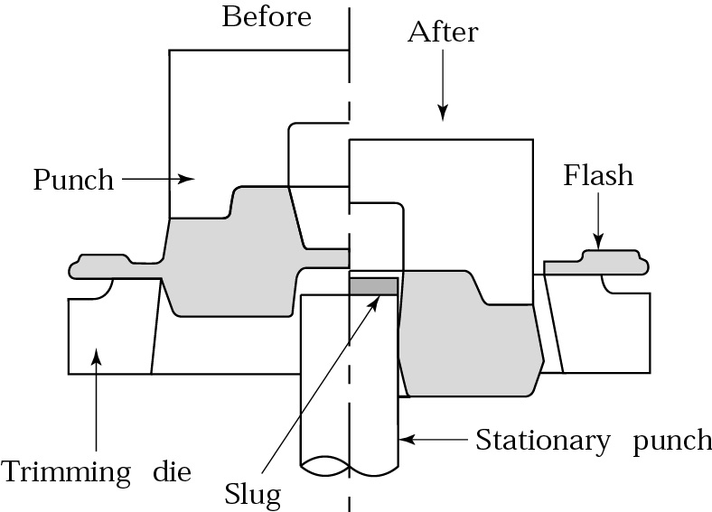
Trimming Flash from a Forged Part
Figure. Trimming flash from a forged part. Note that the thin material at the center is removed by punching.

Slide 27
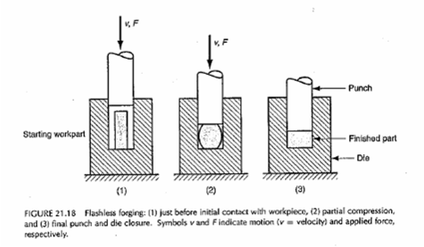
Flashless forging

Slide 28
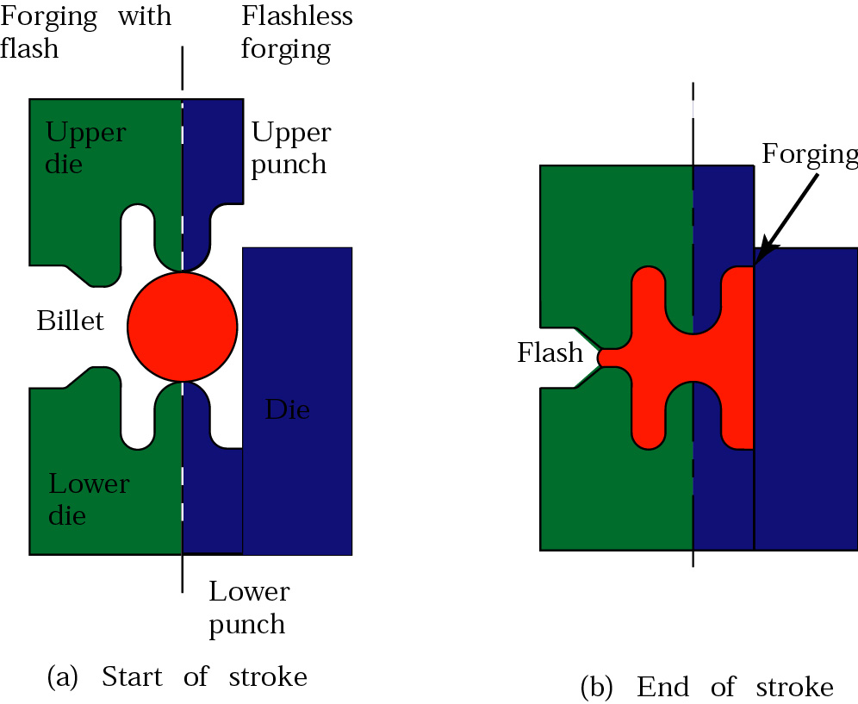
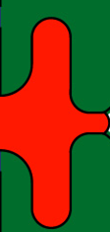
Normal

Slide 29
Flashless Forging

Slide 30
Comparison of Forging With and Without Flash
Figure 14.9 Comparison of closed-die forging to precision or flashless forging of a cylindrical billet. Source: H. Takemasu, V. Vazquez, B. Painter, and T. Altan.

Slide 31
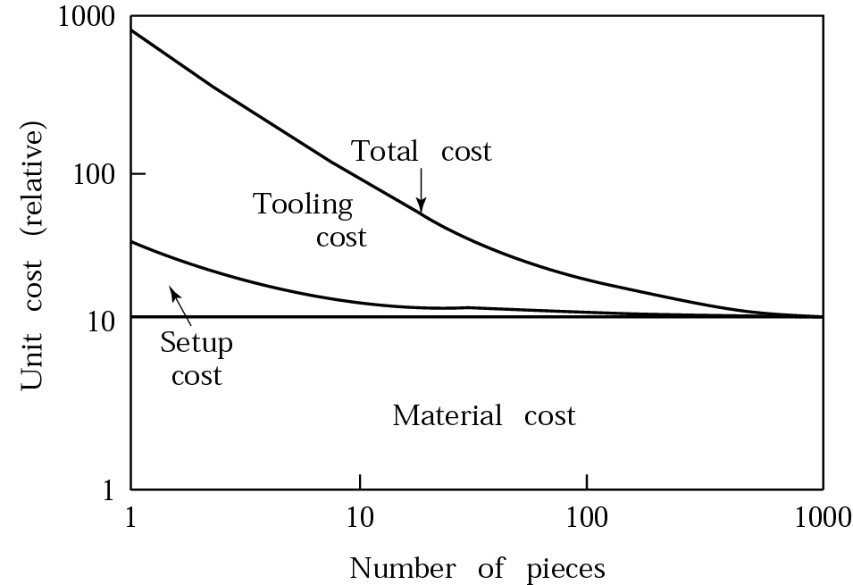
Unit Cost in Forging
Figure Typical unit cost (cost per piece) in forging; note how the setup and the tooling costs per piece decrease as the number of pieces forged increases, if all pieces use the same die.

Slide 32
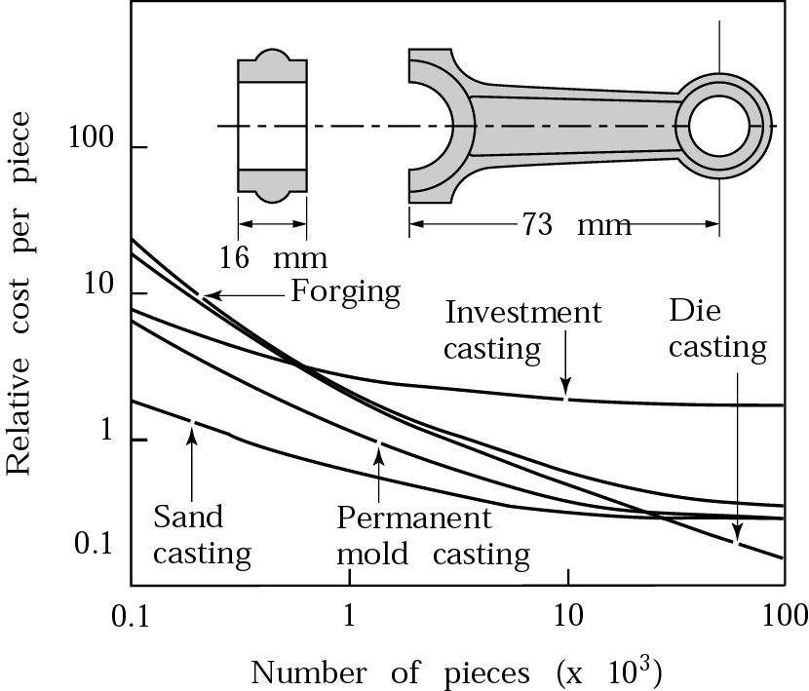
Relative Unit Costs of a Small Connecting Rod
Figure .
Relative unit costs of a small connecting rod made by various forging and casting processes. Note that, for large quantities, forging is more economical. Sand casting is the more economical process for fewer than about 20,000 pieces.

Slide 33
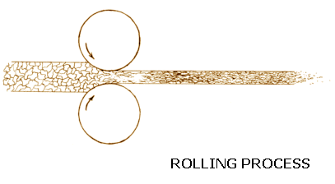
Rolling
Important Applications:
Steel Plants,
Raw stock production (sheets, tubes, Rods, etc.)
Screw manufacture

Slide 34
Rolling Basics
Screw manufacture:

Slide 35
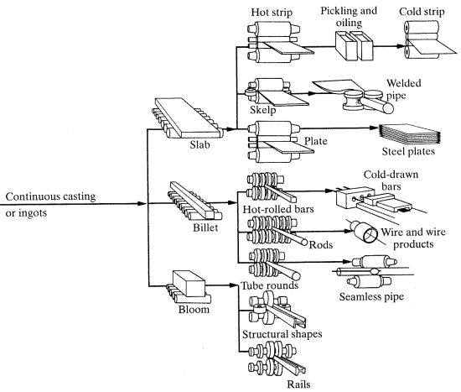
Hot-rolling
Cold-rolling
Rolling

Slide 36
Rolling Theory
Roll speed,v_{t}
θ
R=roll radius
p=roll pressure
t₀
t_{t}
v_{t}
v₀
L=contact length
v_{t}

Slide 37
Distorted roll
Original shape
Distorted roll
t_{max}
t_{min}
Cross section of the sheet

Slide 38
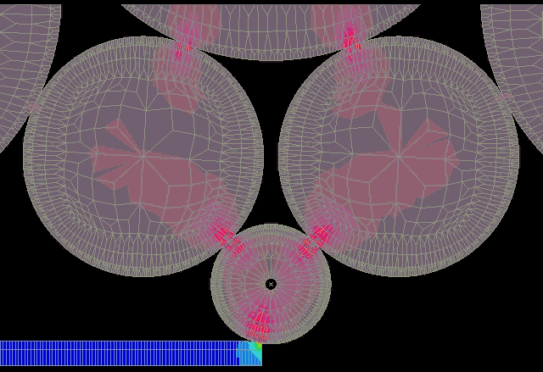
Rolling force

Slide 39
Various Configurations
v_{t}
v_{t}
v₀
v₀
v₀
v_{t}
v_{t}
v_{t}
v_{t}
v_{t}
v₁
v_{t}
v₂
Two high
v_{t}
Four high
Three high
v_{t}
v₀
v_{t}
v₀
v₁
v₂
v₃
Cluster Mill
Tandem rolling mill

Slide 40
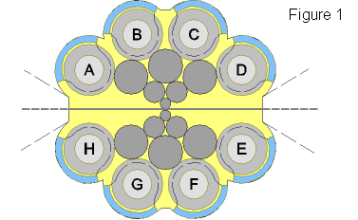
Cluster Mill

Slide 41
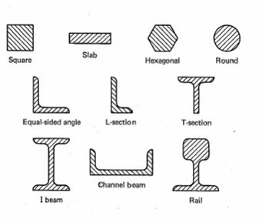
Shapes Produced by rolling

Slide 42
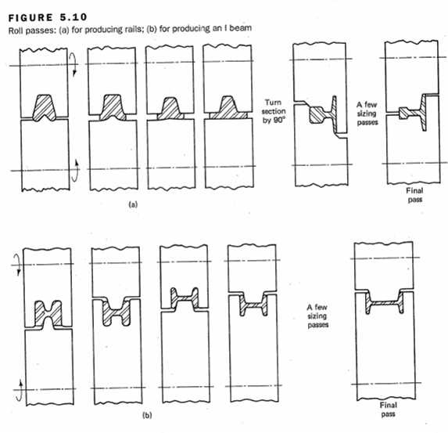

Slide 43
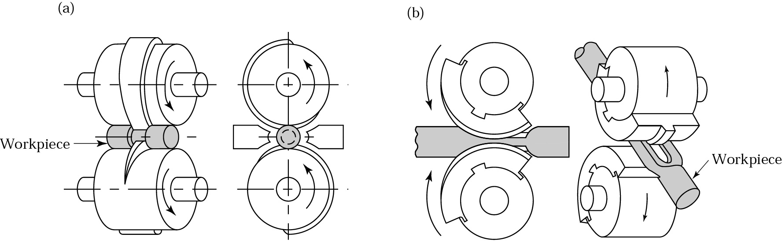
Roll-Forging
Figure 14.13 Two examples of the roll-forging operation, also known as cross-rolling. Tapered leaf springs and knives can be made by this process. Source: (a) J. Holub; (b) reprinted with permission of General Motors Corporation.

Slide 44
Roll piercing
Compressive Force
Rolls
Mandrel
Tensile
Stresses
Finished
Tube
Starting Cylinder

Slide 45
Friction and lubrication
Friction is undesirable;
  Metal flow in the work is retarded
  The forces to perform are increased
  Rapid wear of tooling
Sticking

Slide 46
Lubrication
Mineral oils
Graphite
Glass
Graphite in water or mineral oil is a common for hot forging

Slide 47

Sheet Metal Processes
Raw material: sheets of metal, rectangular, large
Raw material Processing: Rolling (anisotropic properties)
Processes:
Shearing
Punching
Bending
Deep drawing

Slide 48
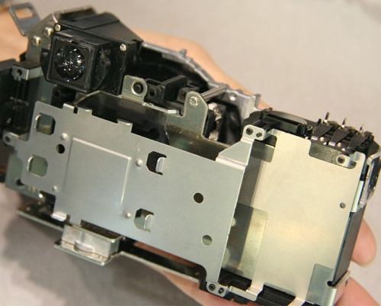
Bending
Body of Olympus E-300 camera
component with multiple bending operations
component with punching,
bending, drawing operations
[image source: dpreview.com]

Slide 49
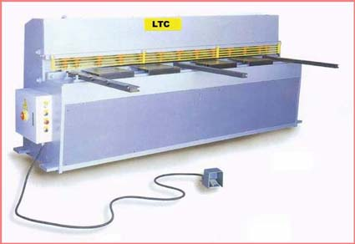
Shearing
A large scissors action, cutting the sheet along a straight line
Main use: to cut large sheet into smaller sizes for making parts.

Slide 50

Punching
Cutting tool is a round/rectangular punch,
that goes through a hole, or die of same shape

Slide 51
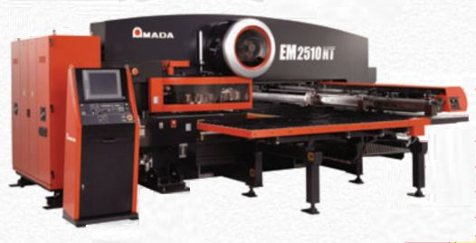
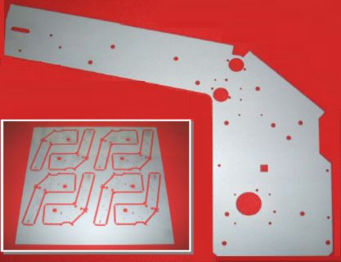
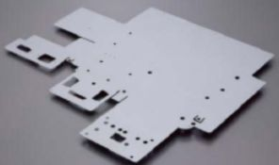
Punching
Main uses: cutting holes in sheets; cutting sheet to required shape
nesting of parts
typical punched part
Exercise: how to determine optimal nesting?

Slide 52
Blanking
Piecing
Strip (Scrap)
Part
Blank (Part)
Slug (Scrap)

Slide 53
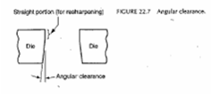

Slide 54
Shearing Operation
Punch
Die
Side View
Front View

Slide 55
C = at
C = clearance,
a = allowance
t = Thickness (plate)

Slide 56
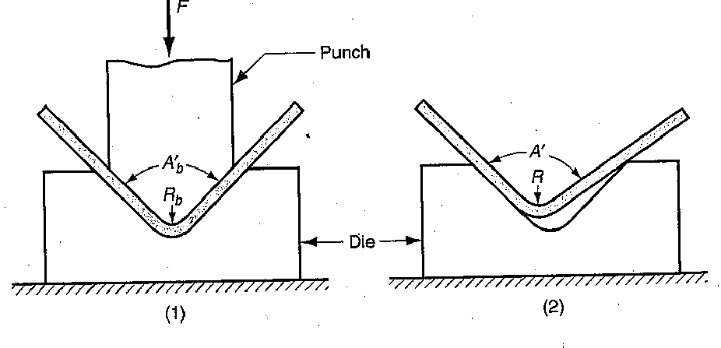

How to handle springback:
Bending: springback
(a) Compensation: the metal is bent by a larger angle
(b) Coining the bend:
at end of bend cycle, tool exerts large force, dwells
coining: press down hard, wait, release

Slide 57
Deep Drawing
Tooling: similar to punching operation,
Mechanics: similar to bending operation
Common applications: cooking pots, containers, …

Slide 58
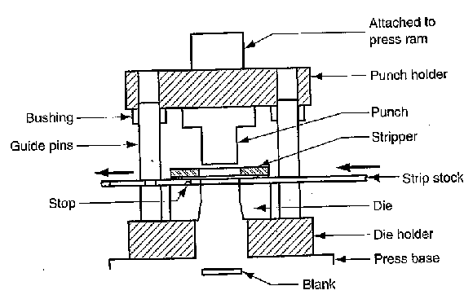
Punch Die

Slide 59
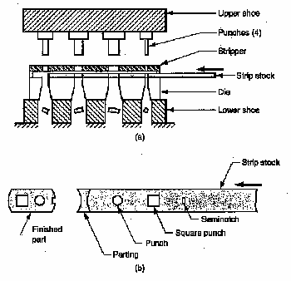
Progressive Die
https://youtu.be/NuFpzJLMnFs?t=88

Slide 60
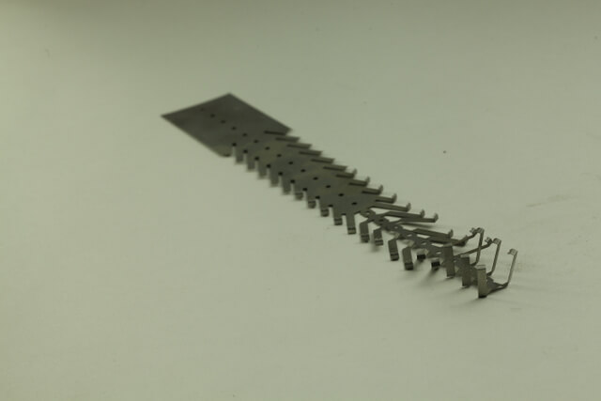
Progressive Die Stamping
Fabricating complex parts in earlier days was an inefficient and costly affair. Either a manufacturer could repeatedly change the tool in a single press or use multiple presses each performing single action to produce one part. This resulted in long load times and a high labor cost.
With progressive die stamping, a manufacturer can eliminate all these hassles and produce better quality parts faster and in a cost-effective manner.

Slide 61
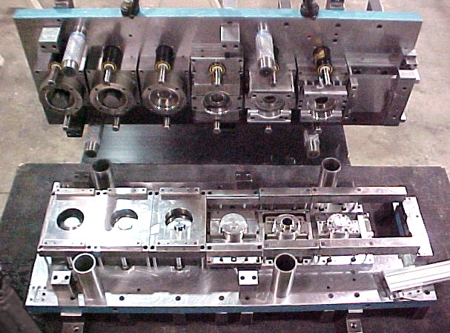
Progressive Die
https://youtu.be/10vNgC4LpkQ?t=113

Slide 62
